Slide 1

Friday 10th September 2021
Semester 1
BUT
The Invention of the USB Flash Drive
Matis CHABANAT

Slide 2
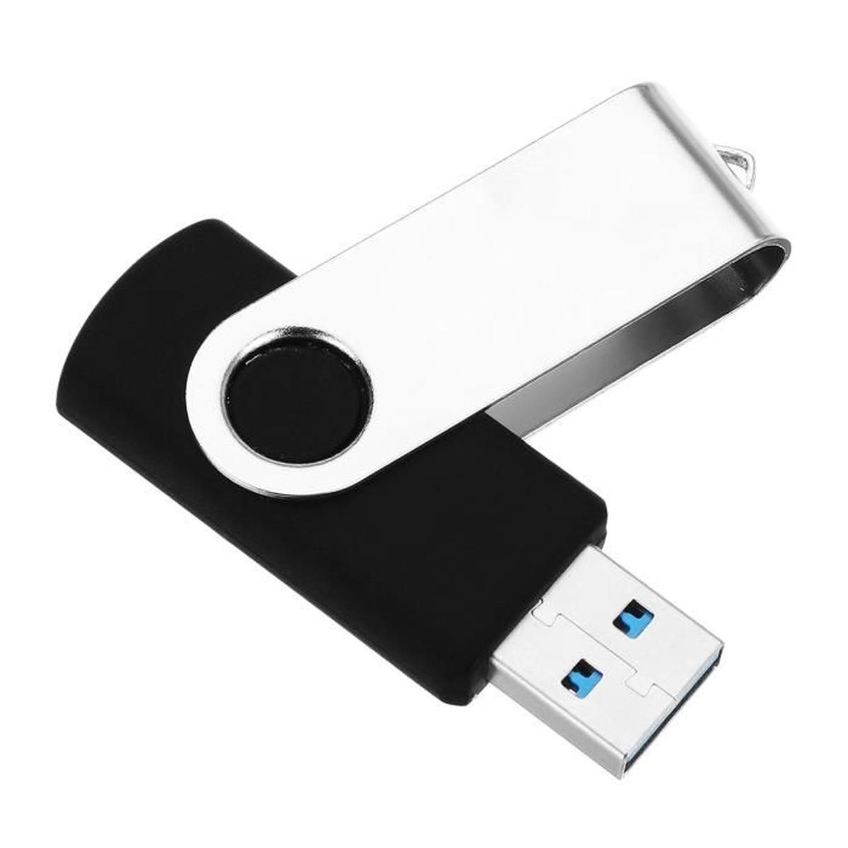
USB FLASH DRIVE

Slide 3
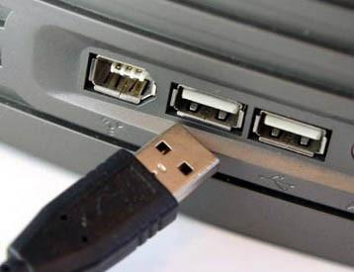

USB port
Transfer between 2 computers

Slide 4

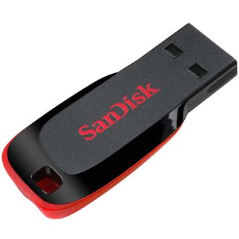
650 mo
32 go
10€
25€

